Slide 1

ESG vs SIN
P. Alex Hertel
Akrem Mohamed
Jeff Myers
Lam Nguyen

Slide 2

Objective
Define ESG & SIN stocks
Compare and contrast past performance of ESG and SIN portfolios
Slice data to look at how the portfolios reacted during key events from 2008 – 2020
Simulate future performance with Monte Carlo Simulation
Finally, we wanted to draw conclusions on both the ESG & SIN portfolios utilizing the framework of portfolio management

Slide 3
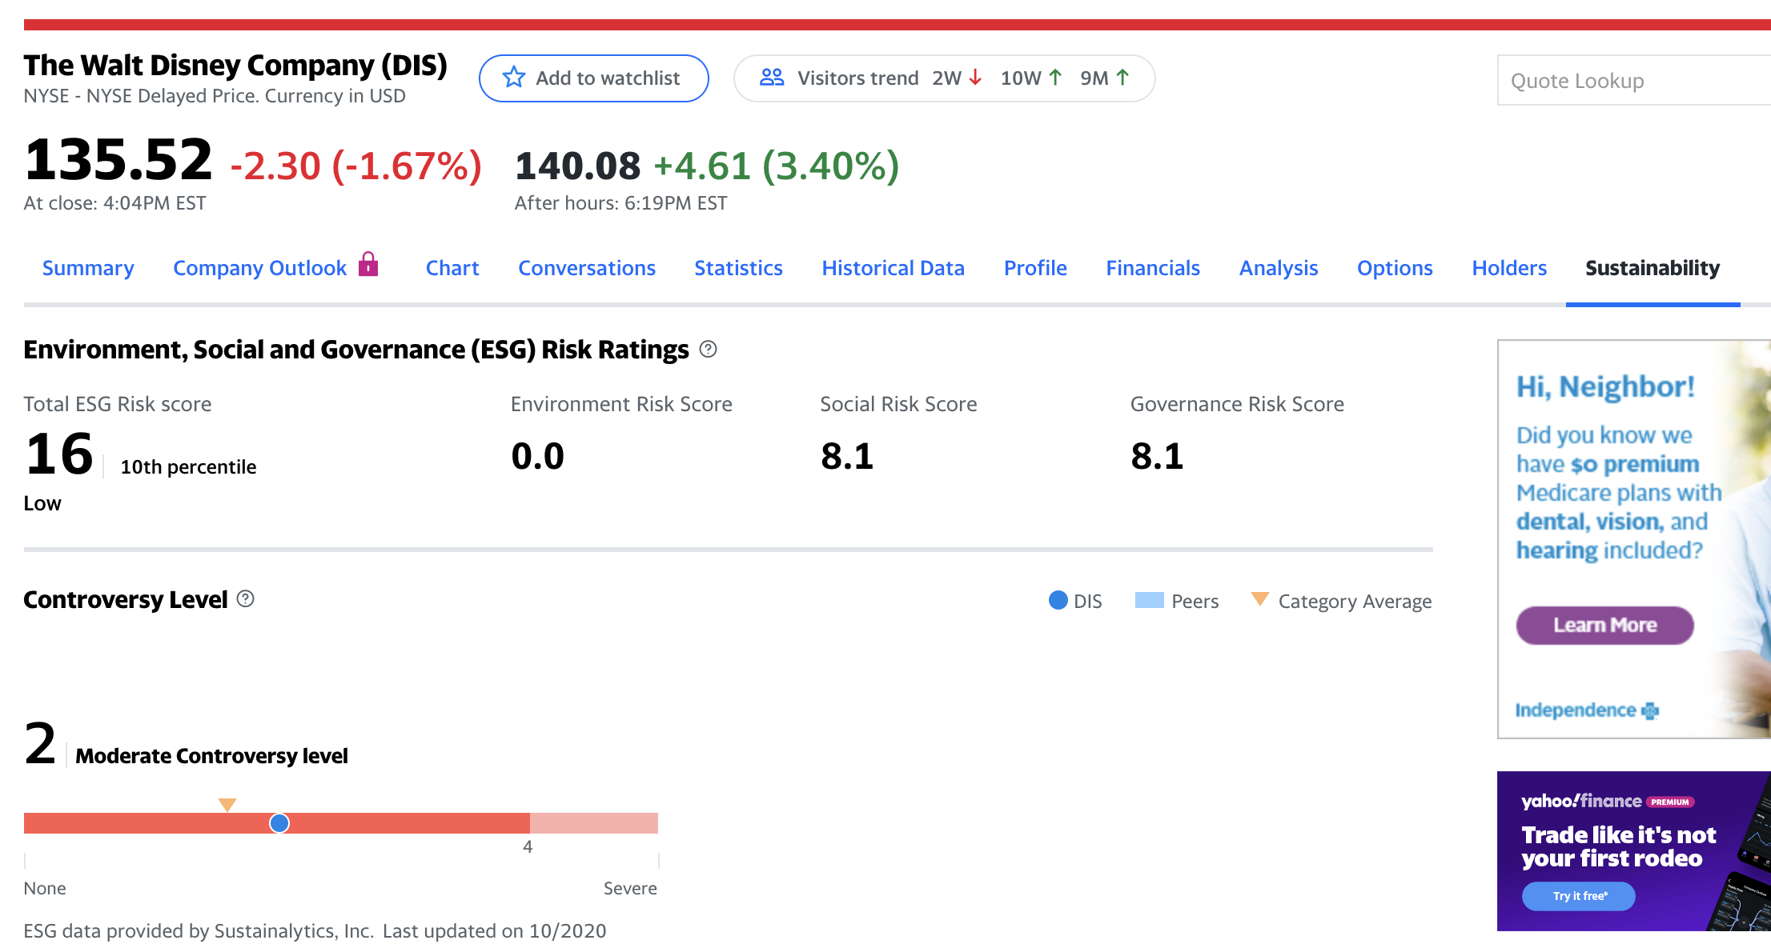
Defining an ESG stock
Environmental, Social, and Governance
Increasing popularity amongst younger investors

Slide 4
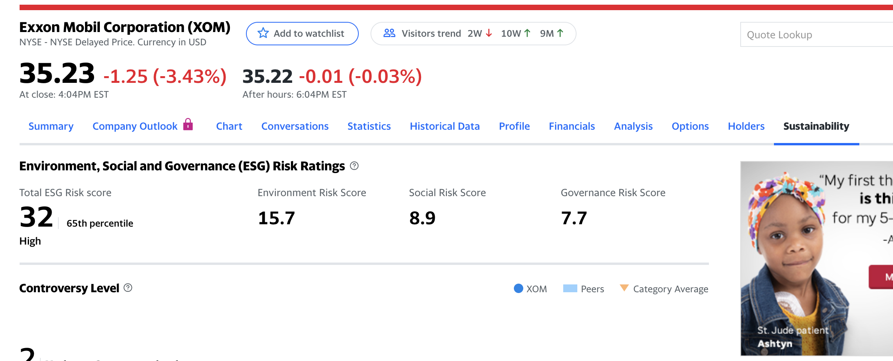
Defining a SIN stock
A SIN stock is a publicly traded company involved in or associated with an activity that is considered unethical or immoral

Slide 5
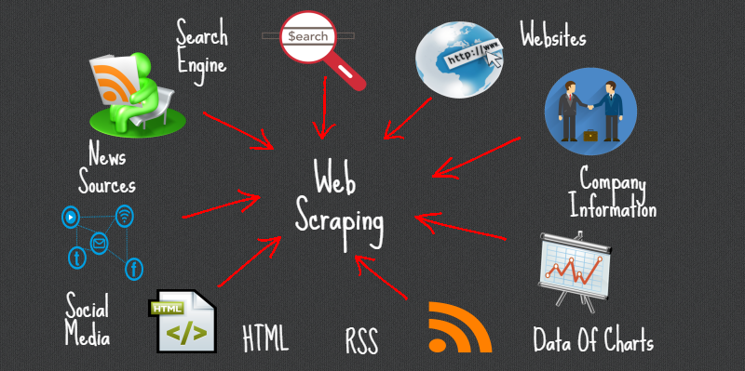
Libraries Used
Beautiful Soup Library to parse data from Yahoo Finance to collect an ESG score on all S&P 500 stocks
Pandas_datareader

Slide 6
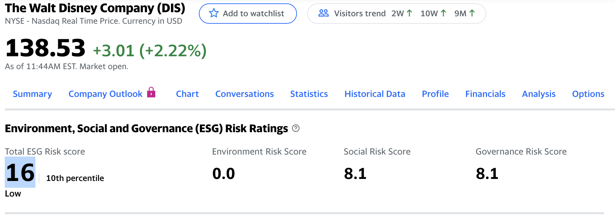
Beautiful Soup

Slide 7
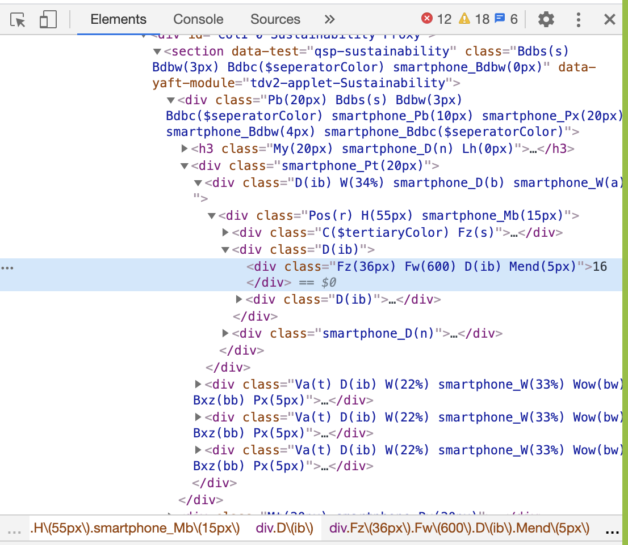
Beautiful Soup

Slide 8
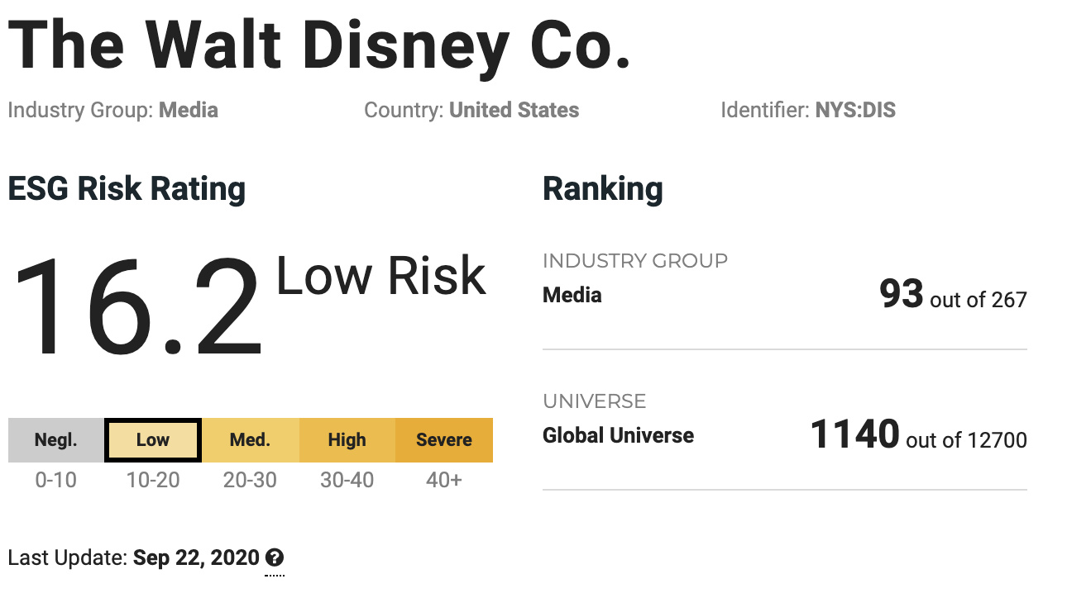
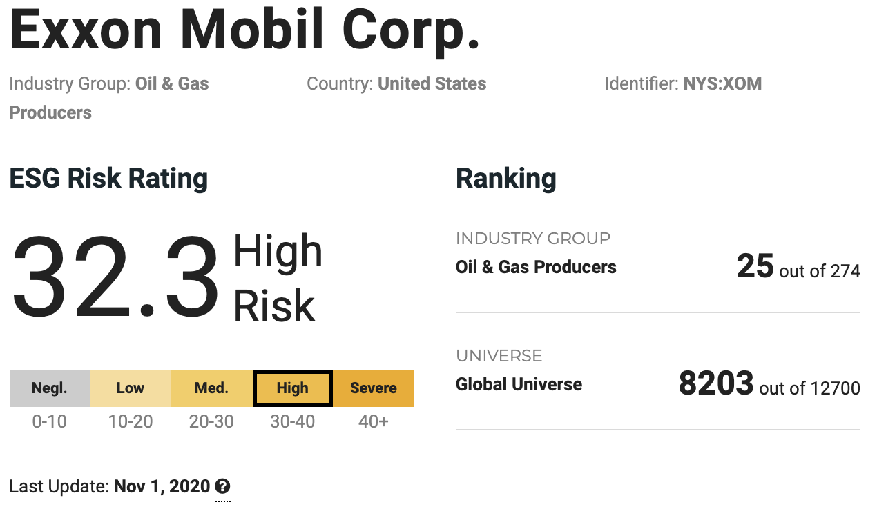
Yahoo ESG Ratings

Slide 9
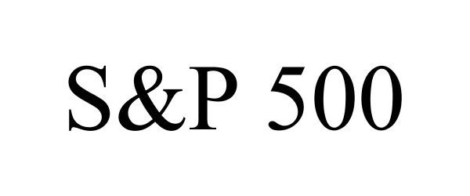
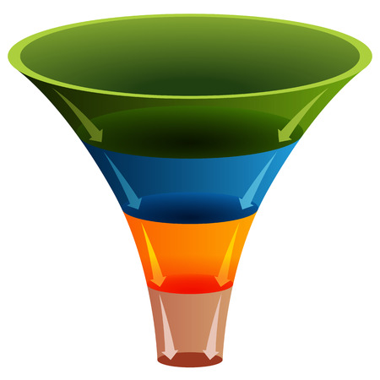


Filtered data
ESG RATINGS
39 SIN STOCKS
33 ESG STOCKS
HISTORICAL RETURNS

Slide 10





Sample ESG Stocks in the Portfolio

Slide 11





Sample SIN Stocks in the Portfolio

Slide 12
Showcasing the Dashboard

Slide 13
Past Performance ESG & SIN Portfolio 01/2008-11/2020

Slide 14
Scenario Analysis
Financial Crisis
Flash Crash
Brexit
Longest Government Shutdown
Yield Curve Inversion
COVID Crash

Slide 15
Financial Crisis 09/15/2008 - 04/02/2009

Slide 16
Flash Crash 05/06/2010 - 05/20/2010

Slide 17
Brexit 06/23/2016 - 07/07/2016

Slide 18
Longest Government Shutdown 12/22/2018 - 01/25/2019

Slide 19
Yield Curve Inversion 05/03/2019 – 01/03/2020

Slide 20
COVID Crash 02/20/2020 – 04/07/2020

Slide 21
Montecarlo Simulation for ESG Stocks

Slide 22
Montecarlo Simulation SIN stocks

Slide 23
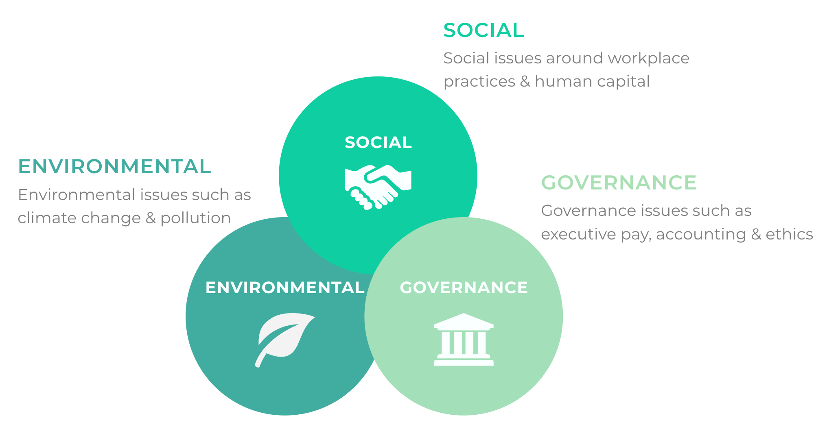
Conclusion
ESG WINS!!

Slide 24
Errors and Flaws with the Analysis
Alpaca errors
ESG ratings change over time
Utilizing a benchmark to compare the ESG and SIN portfolio i.e. S&P 500
Portfolio skewness i.e. tech vs. energy
Past Performance doesn’t guarantee future results

Slide 25
Q&A

Slide 26
Resources
https://www.investopedia.com/terms/e/environmental-social-and-governance-esg-criteria.asp
https://finance.yahoo.com/
https://www.forbes.com/?sh=321528852254
https://towardsdatascience.com/

